Slide 1


Prachi Choughule
15/06/2022

Slide 2

Outline
Executive Summary
Introduction
Methodology
Results
Conclusion
Appendix

Slide 3
Executive Summary
Collected data from public SpaceX API and SpaceX Wikipedia page. Created labels column ‘class’ which classifies successful landings. Explored data using SQL, visualization, folium maps, and dashboards. Gathered relevant columns to be used as features. Changed all categorical variables to binary using one hot encoding. Standardized data and used GridSearchCV to find best parameters for machine learning models. Visualize accuracy score of all models.
Four machine learning models were produced: Logistic Regression, Support Vector Machine, Decision Tree Classifier, and K Nearest Neighbors. All produced similar results with accuracy rate of about 83.33%. All models over predicted successful landings. More data is needed for better model determination and accuracy.

Slide 4
Introduction
SpaceX advertises Falcon 9 rocket launches on its website, with a cost of 62 million dollars; other providers cost upward of 165 million dollars each, much of the savings is because SpaceX can reuse the first stage. Therefore if we can determine if the first stage will land, we can determine the cost of a launch. This information can be used if an alternate company wants to bid against SpaceX for a rocket launch.
Space Y wants to compete with Space X. We will be using the information about Space X and create dashboards for the team.
We will train a machine learning model and use public information to find if SpaceX will reuse the first stage.

Slide 5

Section 1

Slide 6
Methodology
Executive Summary
Data collection methodology:
Combined data from SpaceX public API and SpaceX Wikipedia page.
Perform data wrangling
Use one-hot encoding for categorical data
Perform exploratory data analysis (EDA) using visualization and SQL
Perform interactive visual analytics using Folium and Plotly Dash
Perform predictive analysis using classification models
Model tuning using GridSearchCV

Slide 7
Data Collection
Data collection process involved a combination of API requests from SpaceX API and web scrapping data from the Wikipedia page.
SpaceX API
Request (SpaceX API)
Normalize json results into dataframe.
Filter data to only include Falcon 9 launches.
Impute missing data by calculating mean.
Web Scraping
Request html page
Using BeautifulSoup parser parse html table.
Extract data by iterating on table elements.

Slide 8
Data Collection – SpaceX API
https://github.com/prachisc/AppliedDSCapstone/blob/main/jupyter-labs-spacex-data-collection-api.ipynb

Slide 9
Data Collection - Scraping
https://github.com/prachisc/AppliedDSCapstone/blob/main/Module10-Webscrapping.ipynb
Perform HTTP Get request Wikipage to get html response object.
Parse the reponse by creating BeautifulSoup object.
Extract HTML header and table data.
Create dictionary items from extracted data.
Create dataframe from dictionary and then export it to be used along with SpaceX API

Slide 10
Data Wrangling
Create training label with landing outcomes where succuessful = 1 and failure = 0.
Outcome has two components ‘Mission Outcome’ and ‘Landing Location’
New training label column class with value of 1 if Mission Outcome is True and 0 otherwise.
Value Mapping:
True ASDS, True RTLS, & True Ocean – set to -> 1
None None, False ASDS, None ASDS, False Ocean, False RTLS – set to -> 0
https://github.com/prachisc/AppliedDSCapstone/blob/main/labs-jupyter-spacex-Data%20wrangling.ipynb

Slide 11
EDA with Data Visualization
We explored the data by visualizing the relationship between flight number and launch Site, payload and launch site, success rate of each orbit type, flight number and orbit type, the launch success yearly.
This exploration was to find the correlated features that can then be used to create our machine learning model.
https://github.com/prachisc/AppliedDSCapstone/blob/main/EDA%20With%20Data%20Visualization.ipynb

Slide 12
Build an Interactive Map with Folium
Folium maps mark launch sites, successful and unsuccessful landings and proximity to key locations. E.g. Railways, Highways, Cost and city.
This allows us to understand why launch sites may be located where they are. Also visualize successful landings relative to location.
https://github.com/prachisc/AppliedDSCapstone/blob/main/lab_jupyter_launch_site_location.ipynb

Slide 13
Build a Dashboard with Plotly Dash
The interactive dashboard created with Plotly Dash were pie charts aand scatter plot.
Pie char shows the total launches and their status from all or particular launch site.
Scatter plot helps us to see how launch success varies across launch sites, payload mass and booster version category.
https://github.com/prachisc/AppliedDSCapstone/blob/main/ploty_app.py

Slide 14
Predictive Analysis (Classification)
Various classification models were used to perform predictive analysis. The dataset was split into train and test set using sklearn library. The source data was standardized and split into training and test data. Same data was then used across various classification models and the accuracy was compared to find the best performing classification model for the source data.
https://github.com/prachisc/AppliedDSCapstone/blob/main/SpaceX_Machine%20Learning%20Prediction_Part_5.ipynb

Slide 15
Results
Exploratory data analysis results
Interactive analytics demo in screenshots
Predictive analysis results

Slide 16

Section 2

Slide 17
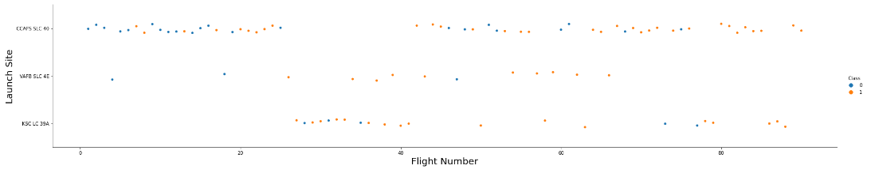
Flight Number vs. Launch Site
The scatter plot shows increase in success rate over time. After flight 20 success rate increases significantly.
CCAFS is the main launch site as there is increased volume from that launch site.

Slide 18
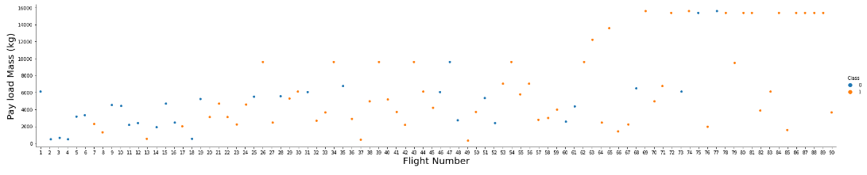
Payload vs. Launch Site
Similar to previous observations launch success rate increased over a time (after flight 20) across different paloads. Higher payload the success rate was much higher.

Slide 19
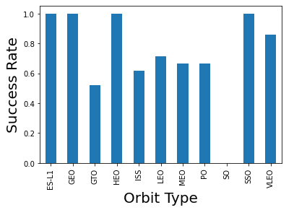
Success Rate vs. Orbit Type
ES-L1, GEO, HEO and SSO have 100% success rate
VELO around 80%
No details found for SO

Slide 20
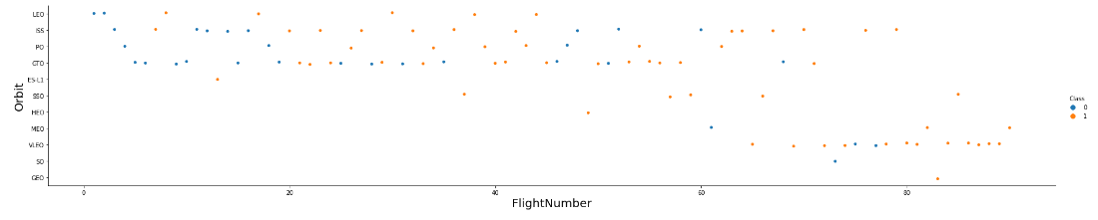
Flight Number vs. Orbit Type
Success rate better after flight 20 for the same orbit types. LEO, ISS, PO, GTO.
Can see more success in VELO orbit type when the launches in that orbit started.

Slide 21
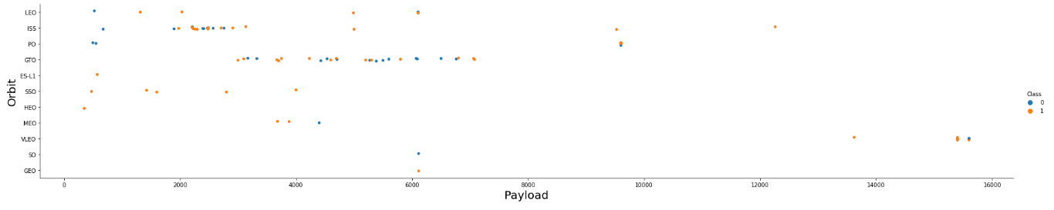
Payload vs. Orbit Type
Most orbits had low mass payload under 6000
VELO orbit had launches with only higher payloads and were mostly successful.

Slide 22
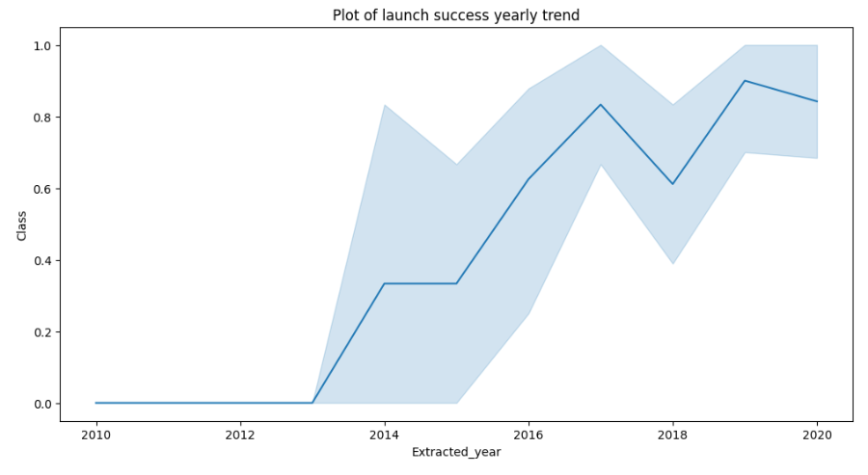
Launch Success Yearly Trend
Success rates increases after 2013

Slide 23
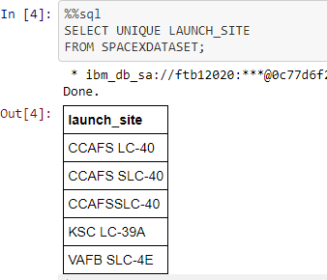
All Launch Site Names
The unique list of launch_sites are as found in the results.

Slide 24
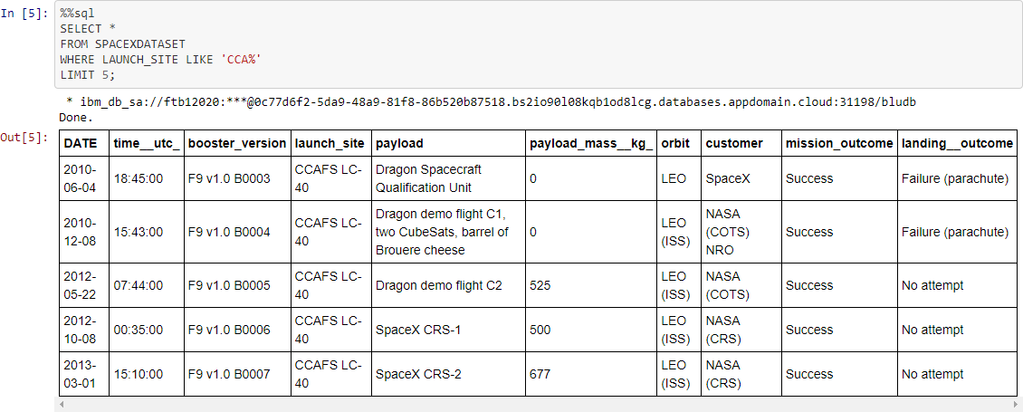
Launch Site Names Begin with 'CCA'
Entries in database with launch site name beginning with CCA

Slide 25
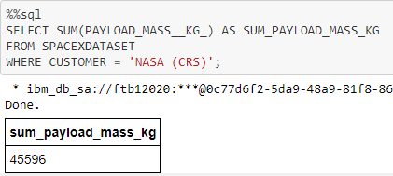
Total Payload Mass
The query uses the SQL function SUM to add the payload_mass from the database for all rows where the customer was NASA (CRS)

Slide 26

Average Payload Mass by F9 v1.1

Slide 27
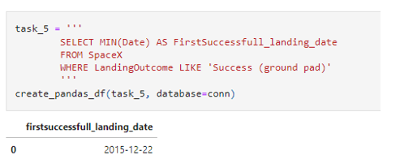
First Successful Ground Landing Date
Use the min sql function to get the first date for successful landing

Slide 28
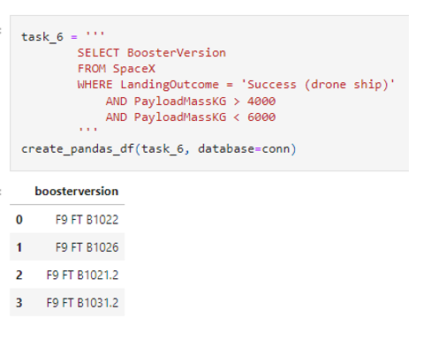
Successful Drone Ship Landing with Payload between 4000 and 6000
Using AND condition to get the correct set of records.

Slide 29
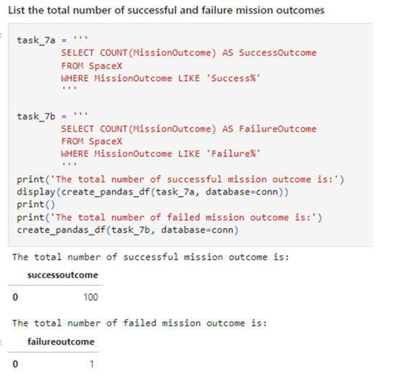
Total Number of Successful and Failure Mission Outcomes
Using like query and % to get the results.

Slide 30
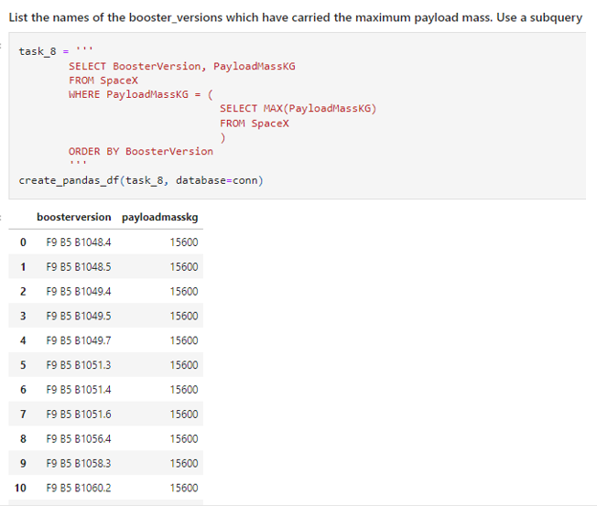
Boosters Carried Maximum Payload

Slide 31
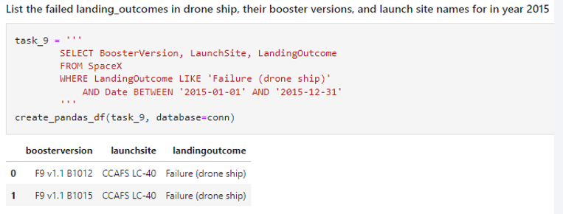
2015 Launch Records

Slide 32
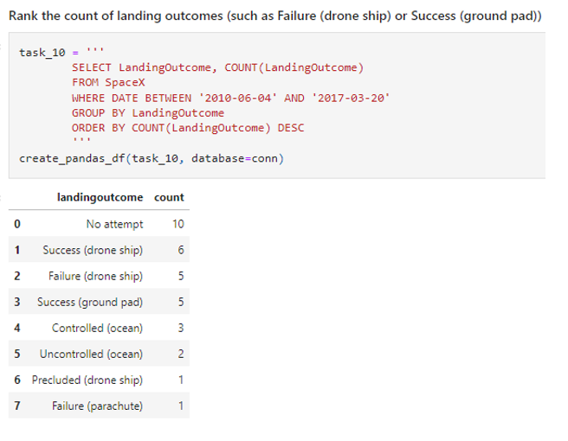
Rank Landing Outcomes Between 2010-06-04 and 2017-03-20

Slide 33

Section 3

Slide 34

All launch sites

Slide 35

Launch sites with markers

Slide 36

Launch sites distance from landmarks

Slide 37

Section 4

Slide 38

Pie chart showing success % by launch site

Slide 39
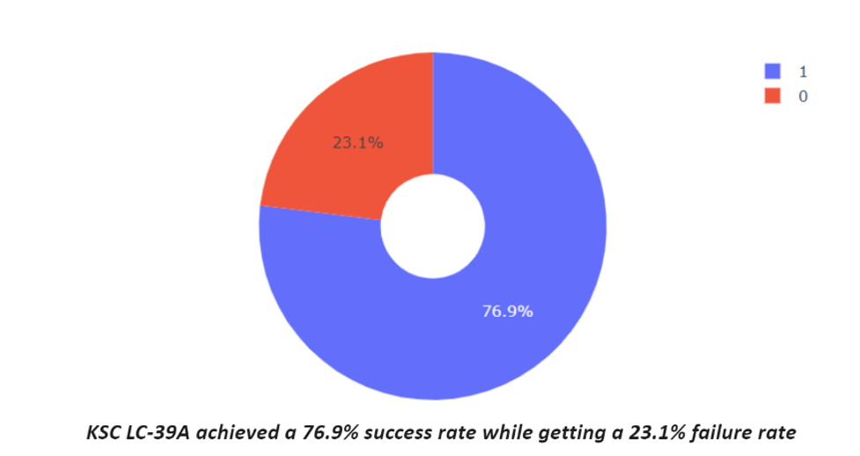
Pie chart with highest launch success ratio

Slide 40

Scatter plot Payload vs Launch Outcome

Slide 41

Section 5

Slide 42
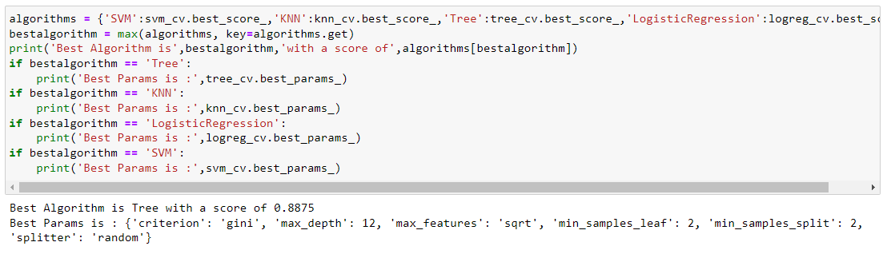
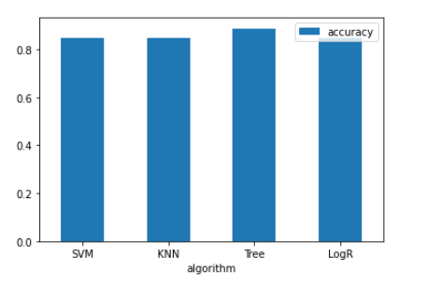
Classification Accuracy

Slide 43
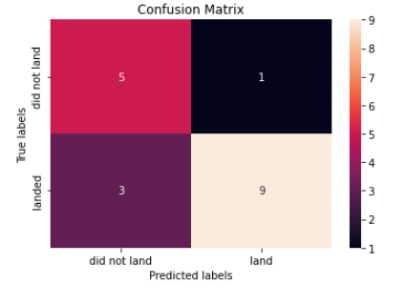
Confusion Matrix

Slide 44
Conclusions
Launch success rates started to increase after 2013
Orbits ES-L1, GEO, HEO, SSO, VLEO had the most success rate.
KSC LC-39A had the most successful launches of any sites.
The Decision tree classifier is the best machine learning algorithm for this task.

Slide 45
Appendix
GitHub Repository URL
https://github.com/prachisc/AppliedDSCapstone

Slide 46


